Slide 1

Revamping of UAJK Portal: Unveiling New Dimensions through Virtual Exploration
Group Members:
Name Reg No
Sami Gul 2020-UMDB-000859
Zohaib Ali Kazmi 2020-UMDB-001396
Supervisor:
Dr. Zaki Hassan Kazmi

Slide 2
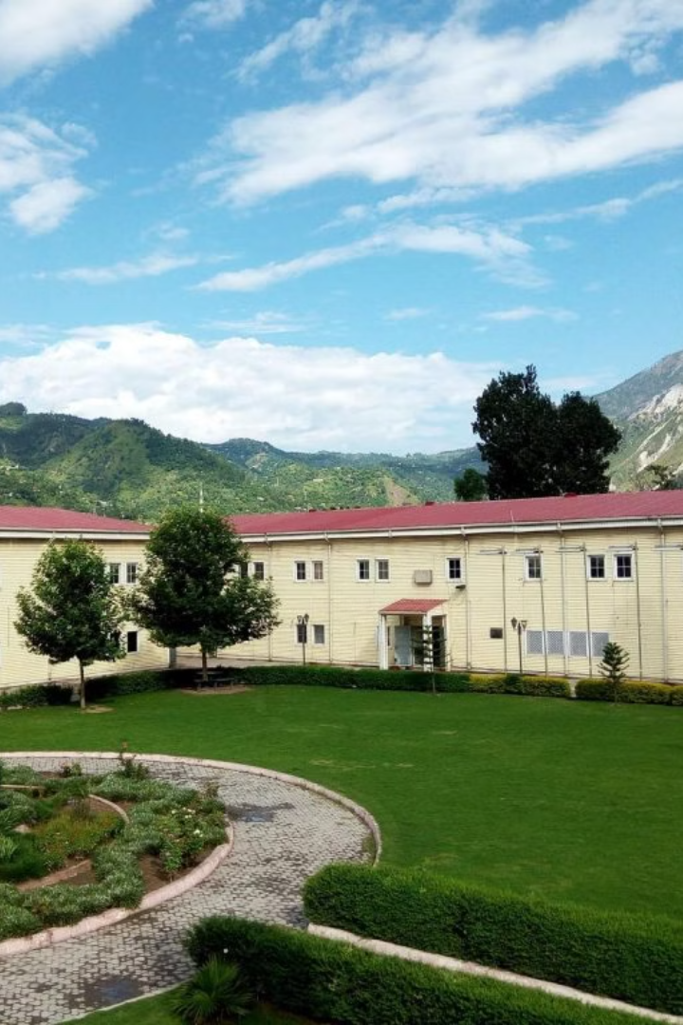
Revamping of UAJK Portal: Unveiling
New Dimensions through Virtual
Exploration
Dive into the digital transformation of the UAJK
website, unlocking innovative pathways for students,
developers, and the university community.

Slide 3
OUTLINES
Introduction
Problem Statement
Existing System
Proposed System
Motivation and Objectives
Features
Development Process
Technical Specifications
System Design
Testing
Achievements
Recommendations and Future Work
Conclusion
Acknowledgements

Slide 4
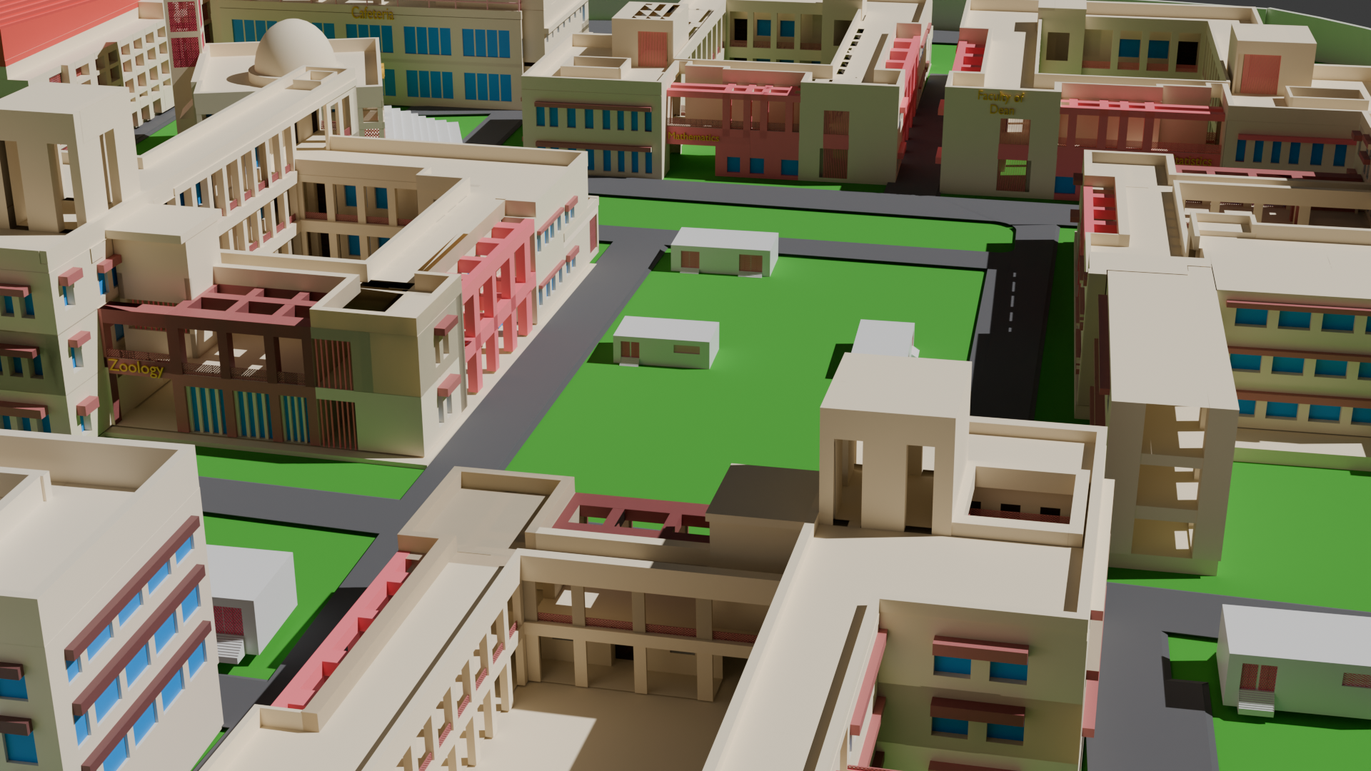
a
INTRODUCTION
The University of Azad Jammu & Kashmir aims to create a comprehensive digital presence with an upgraded portal. The revamped portal incorporates advanced technologies, an intuitive interface, and features like a 3D virtual tour.
Purpose: Enhance user experience for students, faculty, and visitors.
Key Features:
Virtual campus tours.
Modern UI/UX.
Role-based access.
Technologies Used: React, Express.js, Three.js.

Slide 5
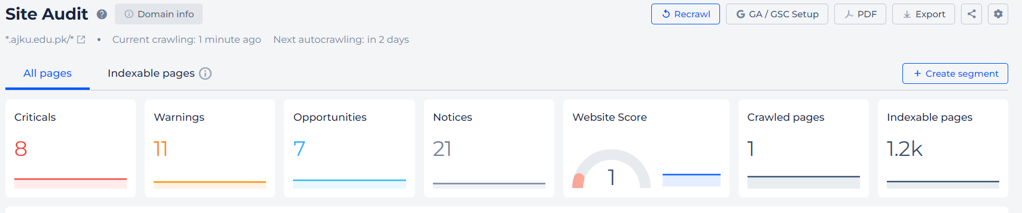
PROBLEM STATEMENT
Current Challenges:
Outdated WordPress design with poor user engagement.
Limited features: No virtual tour or real-time updates.
Poor rankings in speed and performance (e.g. high bounce rate, slow load time).
Static content with delayed updates.
Non-responsive design affecting mobile accessibility.

Slide 6
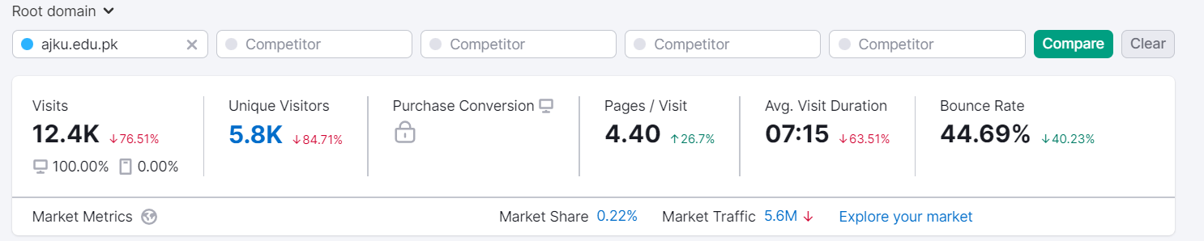
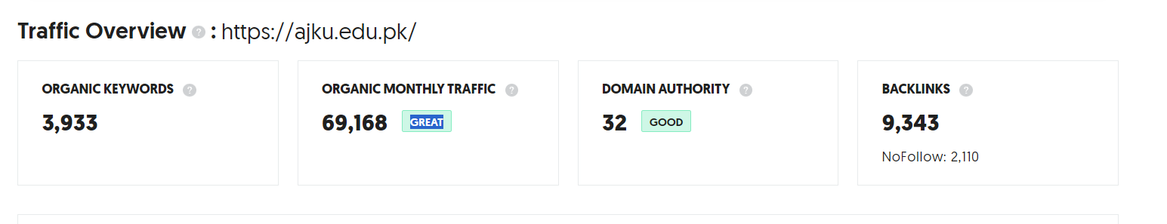
PROBLEM STATEMENT

Slide 7
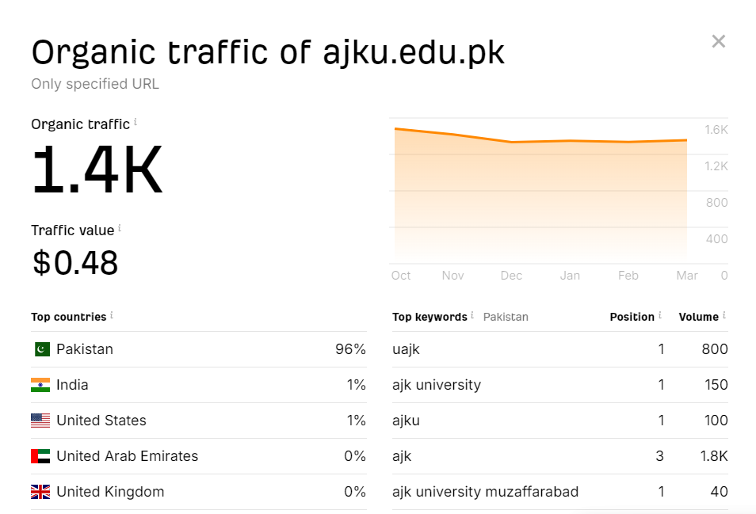
PROBLEM STATEMENT

Slide 8
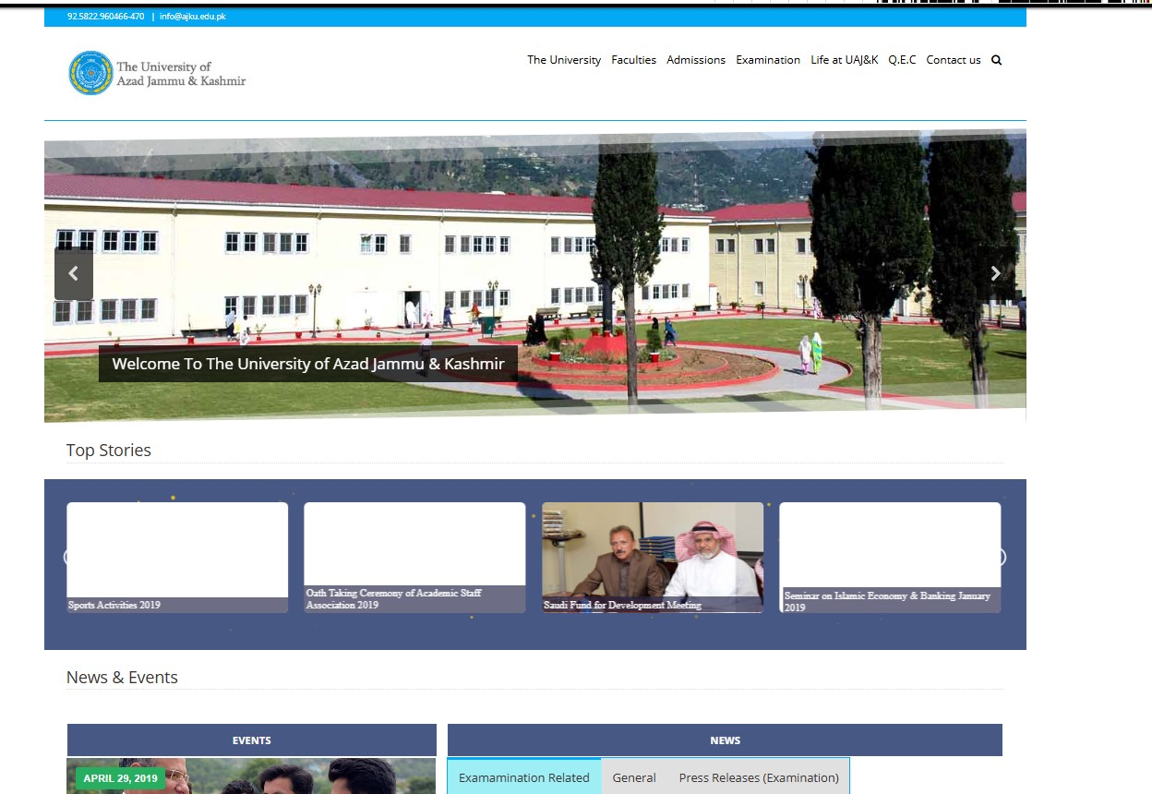
INTERFACE 2019

Slide 9
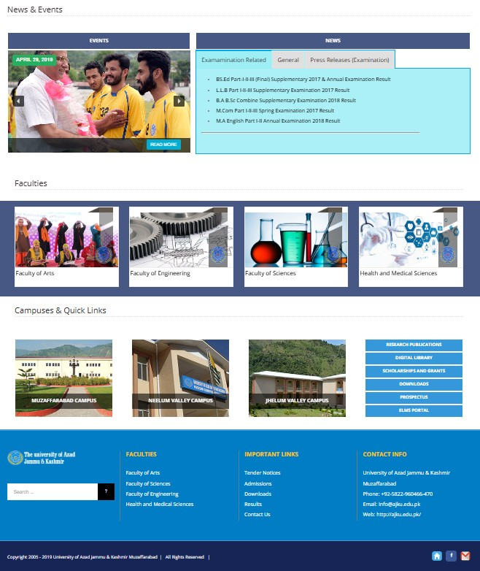

Slide 10
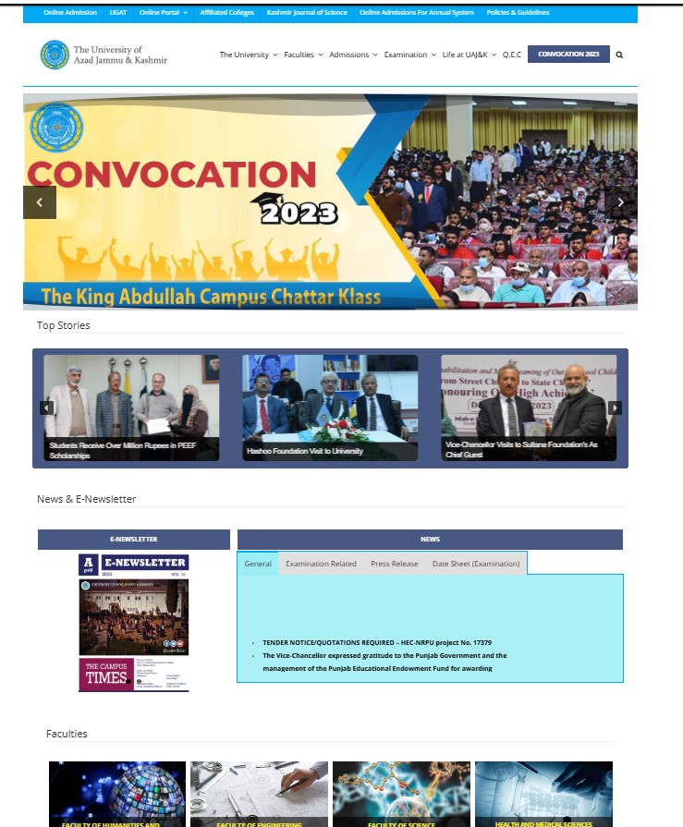
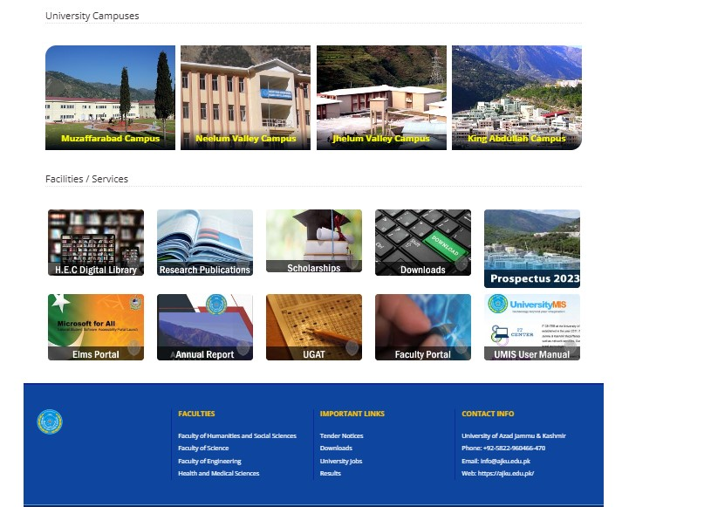
INTERFACE 2024

Slide 11
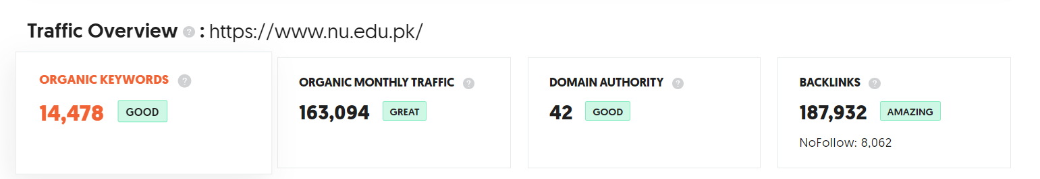
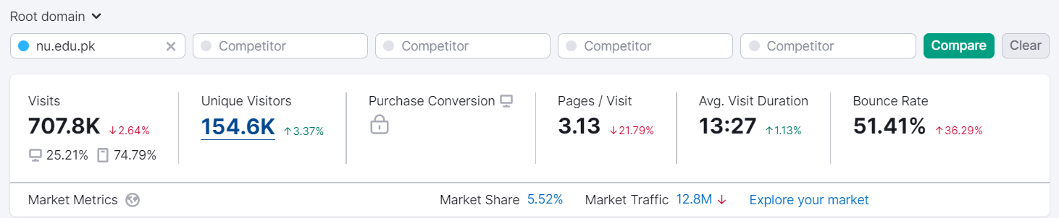
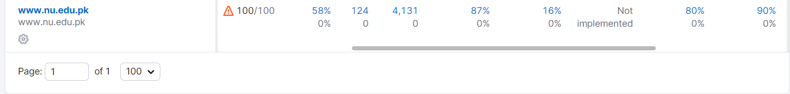
COMPARISON WITH UNIVERSITIES WEBSITE
USING MODREN TECHNOLOGIES

Slide 12
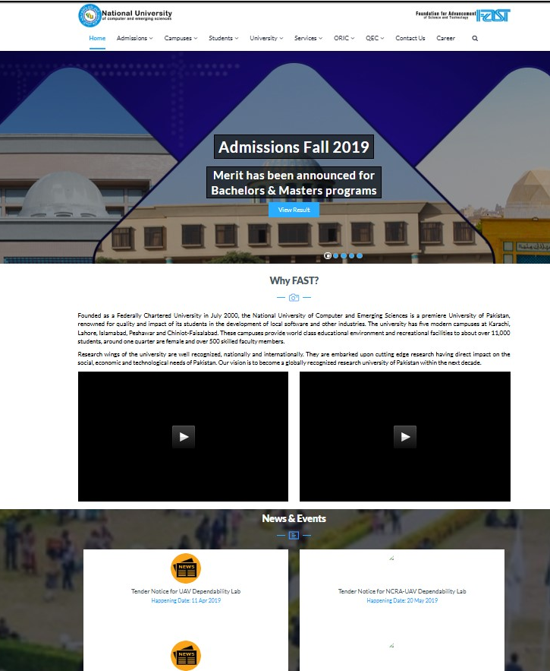
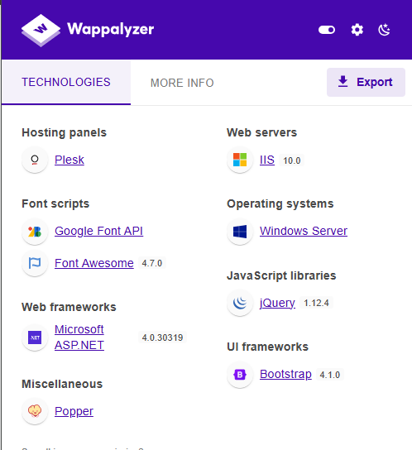
COMPARISON WITH OTHER UNIVERSITIES
WEBSITE IN 2019

Slide 13
MOTIVATION and Objectives
Motivation:
Improve UAJK's digital footprint.
Reflect UAJK's academic and cultural heritage.
Facilitate better communication and interaction with stakeholders.
Objectives:
Enhance user experience and accessibility.
Provide an immersive 3D virtual campus tour.
Ensure up-to-date information delivery with robust technologies.

Slide 14
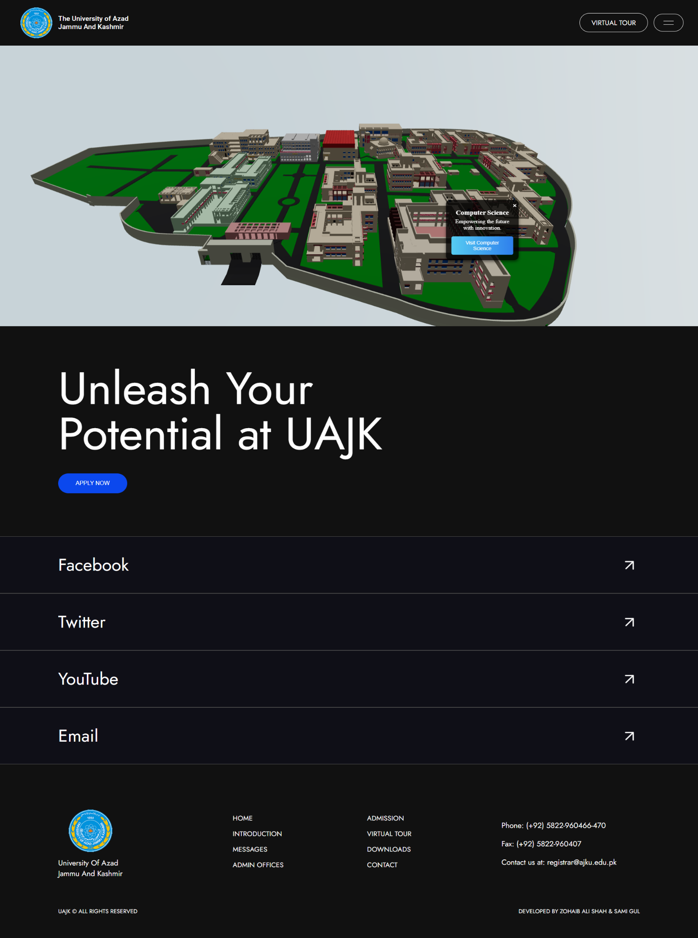
Features
User-Friendly Interface: Modern design optimized for all devices.
3D Virtual Tour: Explore campus facilities with Three.js integration.
Role-Based Access: Separate dashboards for students, faculty, or administrators.
Stay Up-To-Date: Instant updates on events and announcements.
Interactive Maps: Navigate through departmental buildings and facilities.
SEO Practices: Drive more visitors through search engine optimization.

Slide 15
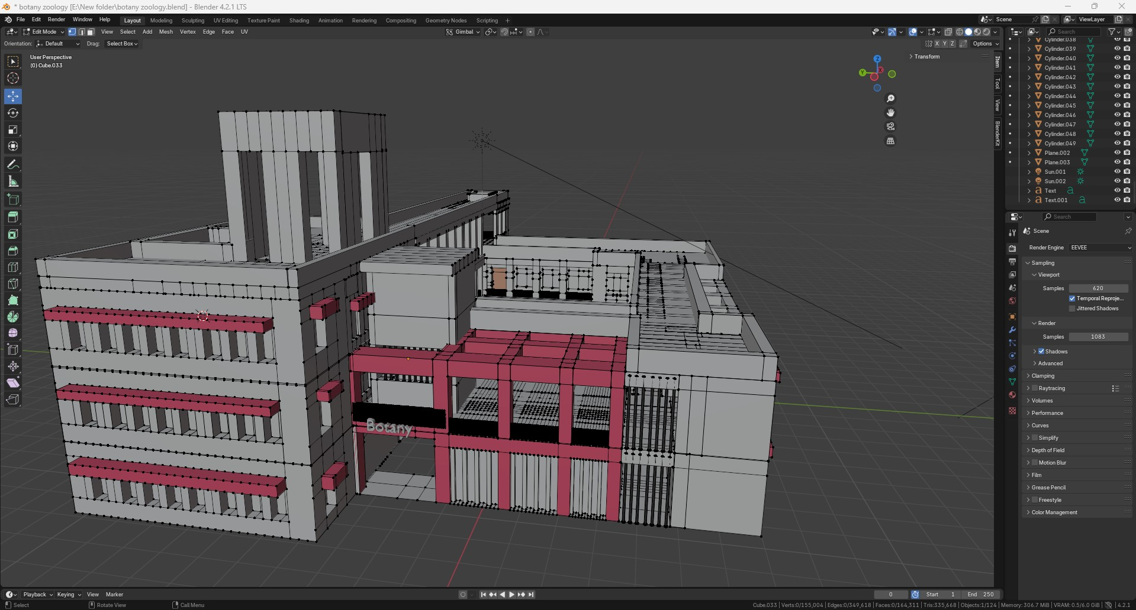
DEVELOPMENT Process
The project followed the Waterfall Model:
Analysis: Identified requirements and system needs.
Design: Created UI/UX layouts and backend architecture.
Development:
Frontend: React.js for dynamic components.
Backend: Express.js for server-side logic.
Database: MongoDB for efficient data handling.
3D Virtual Tour: Designed in Blender, rendered with
Three.js, and integrated for interactive exploration.
Implementation: Optimized and integrated modules.
Testing: Ensured functionality and performance.
Deployment: Delivered with plans for updates.

Slide 16
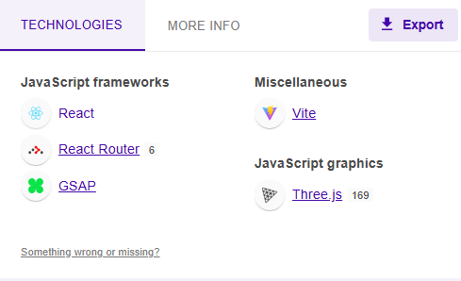





Technical SPECIFICATIONS
Frontend: React.js
Backend: Node.js, Express.js
Database: MongoDB
3D Models: Blender
3D Visualization: Three.js for virtual tours
Additional Libraries: bcryptjs, multer, jsonwebtoken, mongoose

Slide 17
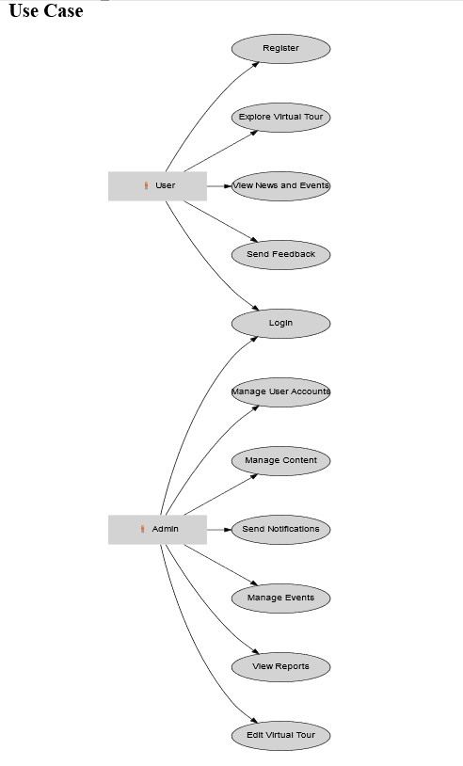
SYSTEM DESIGN
Entity Relationship Diagram (ERD): Depicts relationships between entities like users, departments, courses, and events.
Class Diagram: Shows object-oriented structure and attributes.
Use Case Diagram: Highlights user interactions, including login, virtual tours, and content management.
Activity Diagram: Details workflows like user registration and login.

Slide 18
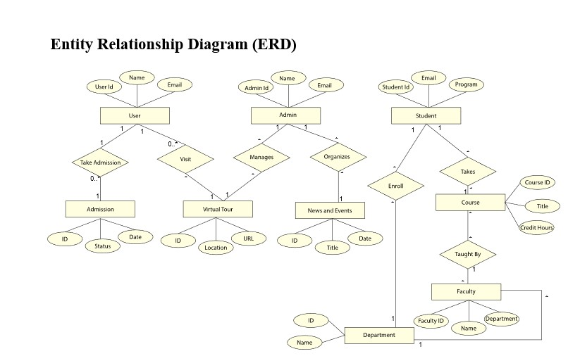
SYSTEM DESIGN

Slide 19
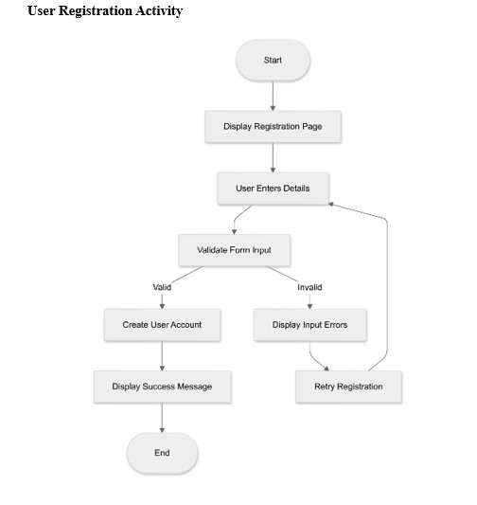
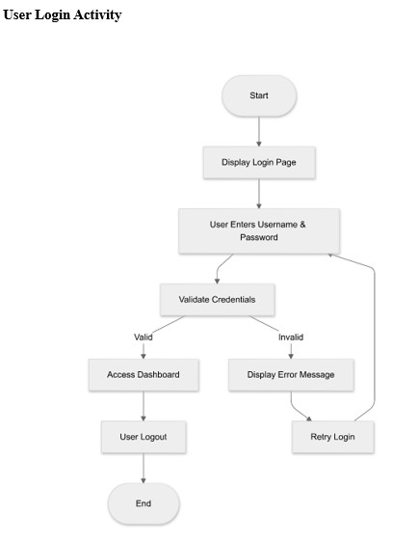
SYSTEM DESIGN

Slide 20
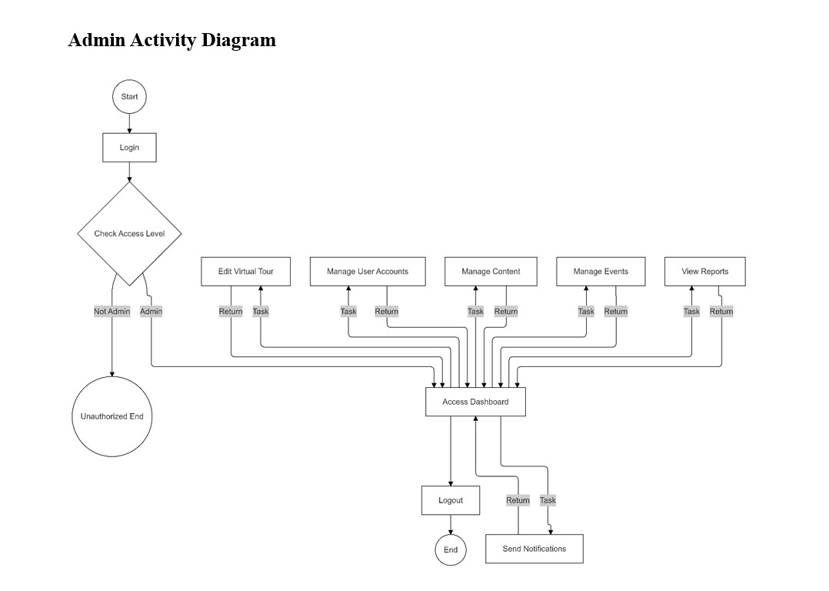
SYSTEM DESIGN

Slide 21
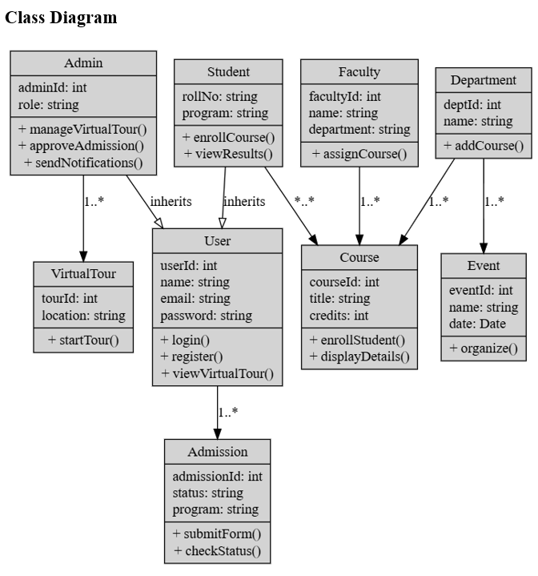
SYSTEM DESIGN

Slide 22


TESTING
The system underwent multiple testing phases:
Unit Testing: Focused on individual components like login functionality.
Integration Testing: Verified interactions between modules, such as virtual tours and notifications.
System Testing: Ensured overall system stability and performance.
Sample Test Case:
Objective: Verify admin login functionality.
Steps: Navigate to login page → Enter credentials → Click "Login."
Expected Result: Redirect to admin dashboard.

Slide 23
ACHIEVEMENTS
Project Completion: Successfully built a modernized portal meeting UAJK's needs.
Technology Proficiency: Mastered React, Express.js, Node.js, Blender, and Three.js.
Enhanced Usability: Developed a user-centric interface with responsive design.
Stakeholder Interaction: Gathered and implemented feedback effectively.

Slide 24
RECOMMENDATIONS AND FUTURE WORK
User Feedback: Regularly collect and implement feedback to improve the portal.
System Updates: Maintain and optimize the system for future needs.
Analytics Integration: Use data-driven insights for better decision-making.
Expand virtual tour coverage to additional campuses.
Integrate advanced features like:
AI Chatbots for instant user queries.
AR/VR Enhancements for more immersive experiences.
Live Application Tracking for admissions.
Mobile Application for better accessibility.

Slide 25
CONCLUSION
The revamped UAJK portal bridges the gap between users and the university by providing:
A modern, efficient, and user-friendly digital presence.
Immersive experiences with virtual tours.
Enhanced accessibility and operational efficiency.
Impact: Strengthens UAJK’s online visibility, fostering engagement and growth.

Slide 26
Acknowledgements
Express gratitude to:
Supervisor: Dr. Syed Zaki Hassan Kazmi.
Department faculty members.
Colleagues, family, and friends for their support.

Slide 27
REFERENCE
https://www.semrush.com/siteaudit/
www.pngegg.com
sitechecker.pro
wappalyzer.com
https://www.nu.edu.pk/
https://archive.org/

Slide 28
THANK YOU

